Slide 1


MTN.*NIX
Automated Environment
Configuration Management
Ansible
Day 2
Siarhei Beliakou
email: siarhei_beliakou@epam.com
2017

Slide 2




Agenda:
Project Structure
Inventory
Roles
Variables
Handlers

Slide 3
Project structure

Slide 4
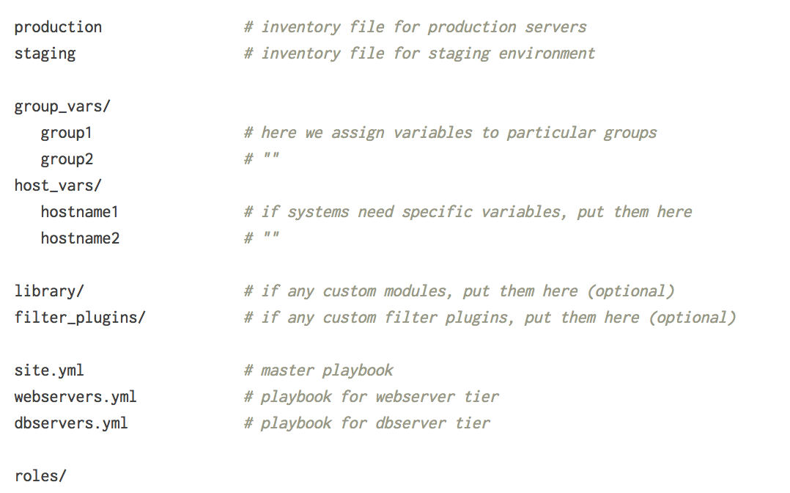
Project structure
http://docs.ansible.com/ansible/playbooks_best_practices.html#directory-layout

Slide 5
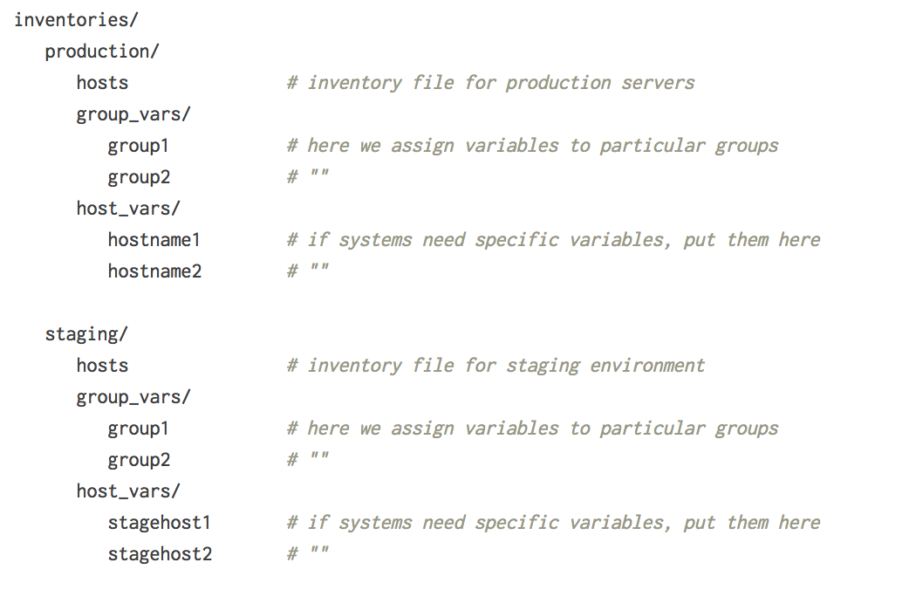
Project structure
http://docs.ansible.com/ansible/playbooks_best_practices.html#directory-layout

Slide 6
Inventory. Deep dive

Slide 7

inventory
Hosts and Groups
Host Variables
Groups of Groups, and
Group Variables
[atlanta]
host1 http_port=80 maxReq=808
host2 http_port=303 maxReq=909
mycorp.com
[webservers]
foo.mycorp.com
bar.mycorp.com
[dbservers]
one.mycorp.com
two.mycorp.com
three.mycorp.com
[atlanta]
...
[raleigh]
...
[southeast:children]
atlanta
raleigh
[southeast:vars] some_server=foo.southeast.mycorp.com
halon_system_timeout=30
self_destruct_countdown=60
escape_pods=2
Group Variables
[atlanta]
host1
host2
[atlanta:vars]
ntp_server=ntp.atlanta.example.com
proxy=proxy.atlanta.example.com
http://docs.ansible.com/ansible/intro_inventory.html
http://docs.ansible.com/ansible/intro_inventory.html#list-of-behavioral-inventory-parameters

Slide 8
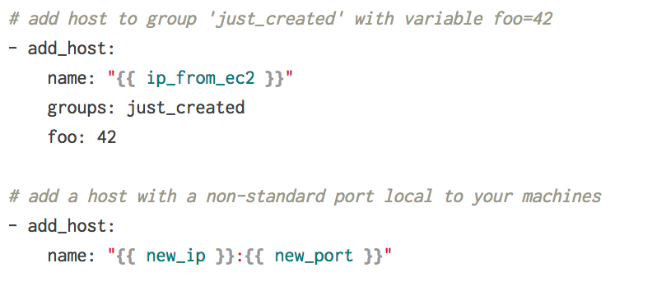
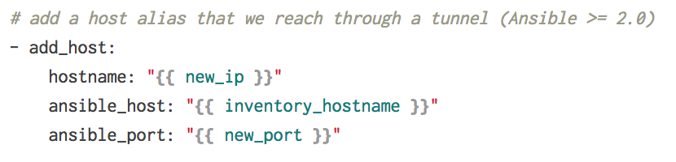
Inventory modules
http://docs.ansible.com/ansible/list_of_inventory_modules.html

Slide 9
Roles

Slide 10
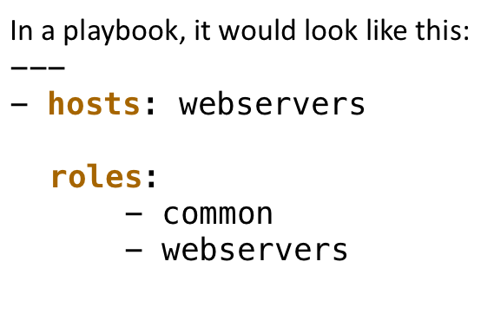
roles
Example project structure:
site.yml
library/
roles/
common/
java/
jenkins/
tomcat/
webservers/

Slide 11
Roles. structure
my_role/
├── README.md
├── defaults/
│ └── main.yml # role default variables
├── files/ # role resources for “copy” module
├── handlers/
│ └── main.yml # role handlers
├── library/ # modules
├── meta/
│ └── main.yml # role dependencies
├── tasks/
│ └── main.yml # role tasks
├── templates/ # role resources for “template” module
├── tests/ # role unit tests
│ ├── inventory
│ └── test.yml
└── vars/
└── main.yml # role variables

Slide 12
Roles. structure
my_role/
├── README.md
├── defaults/
│ └── main.yml # role default variables
├── files/ # role resources for “copy” module
├── handlers/
│ └── main.yml # role handlers
├── library/ # modules
├── meta/
│ └── main.yml # role dependencies
├── tasks/
│ └── main.yml # role tasks
├── templates/ # role resources for “template” module
├── tests/ # role unit tests
│ ├── inventory
│ └── test.yml
└── vars/
└── main.yml # role variables

Slide 13
roles
roles/
myrole/
defaults/
main.yml
vars/
main.yml
meta/
main.yml
tasks/
main.yml
handlers/
main.yml
- name: Play
hosts: ...
vars:
...
roles:
...
tasks:
...
handlers:
...

Slide 14
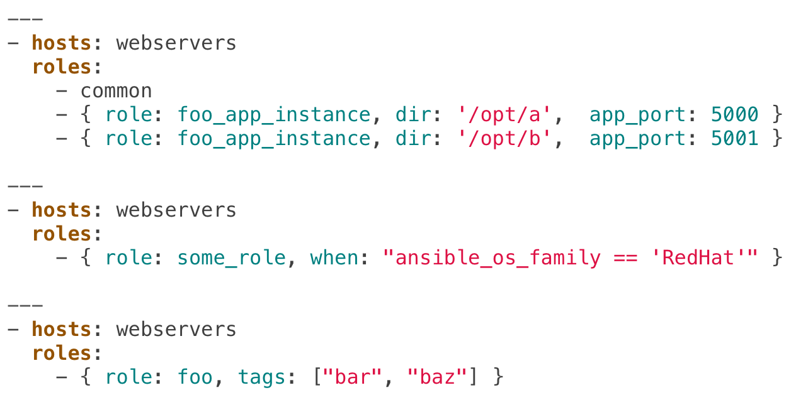
Roles. parameters
Also, should you wish to parameterize roles, by adding variables, you can do so, like this:

Slide 15
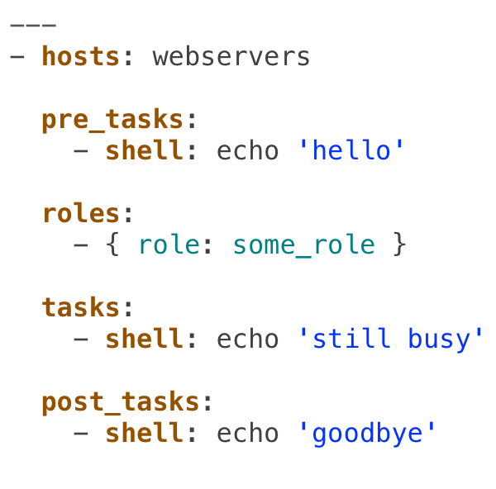
Roles. Order in playbook
If you want to define certain tasks to happen before AND after roles are applied, you can do this:

Slide 16
Roles. dependencies
Role dependencies allow you to automatically pull in other roles when using a role. Role dependencies are stored in the meta/main.yml file contained within the role directory. This file should contain a list of roles and parameters to insert before the specified role, such as the following in an exampleroles/myapp/meta/main.yml:
---
dependencies:
- { role: common, some_parameter: 3 }
- { role: apache, appache_port: 80 }
- { role: postgres, dbname: blarg, other_parameter: 12 }

Slide 17
Roles. initialization
Just folders: $ mkdir -p roles/my_role/{defaults,vars,tasks,meta,handlers} $ touch roles/my_role/{defaults,vars,tasks,meta,handlers}/main.yml
Using “ansible-galaxy”: $ ansible-galaxy init my_role - my_role was created successfully
Using various tools: $ pip install sibl $ mkdir roles $ sibl role my_role

Slide 18
variables

Slide 19
VARIABLES. PRECEDENCE
The last listed variables winning prioritization:
role defaults
inventory vars
inventory group_vars
inventory host_vars
playbook group_vars
playbook host_vars
host facts
registered vars
set_facts
play vars
play vars_prompt
play vars_files
role and include vars
block vars (only for tasks in block)
task vars (only for the task)
extra vars (always win precedence)
http://docs.ansible.com/ansible/playbooks_roles.html

Slide 20
Variables in Command Line
$ man ansible-playbook
…
-e VARS, --extra-vars=VARS Extra variables to inject into a playbook, in key=value key=value format or as quoted JSON (hashes and arrays). To load variables from a file, specify the file preceded by @ (e.g. @vars.yml).
... $ ansible-playbook ... -e somevar=somevalue $ ansible-playbook ... -e "somevar1=somevalue1 somevar2=somevalue2" $ ansible-playbook ... --extra-vars=@vars.yml $ ansible-playbook ... -e "{'somevar1': 'somevalue1', 'somevar2': 'somevalue2'}"

Slide 21
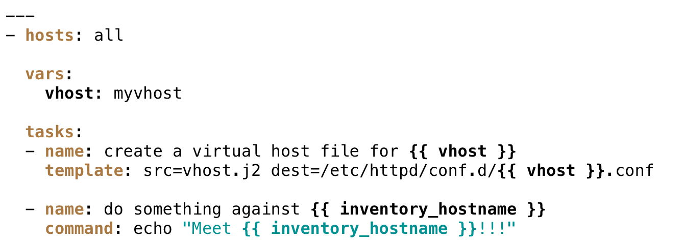
Variables in playbook

Slide 22
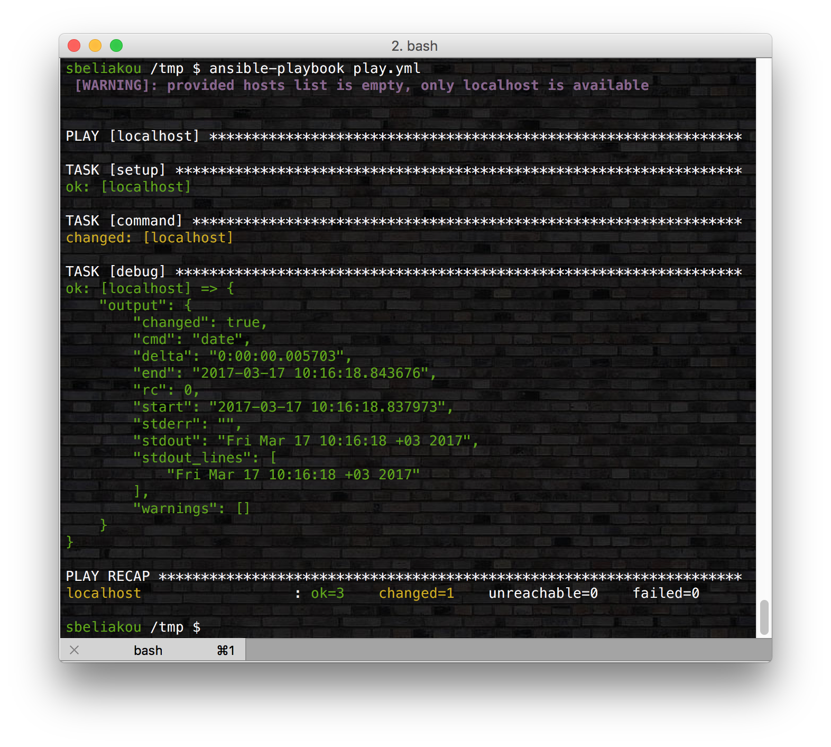
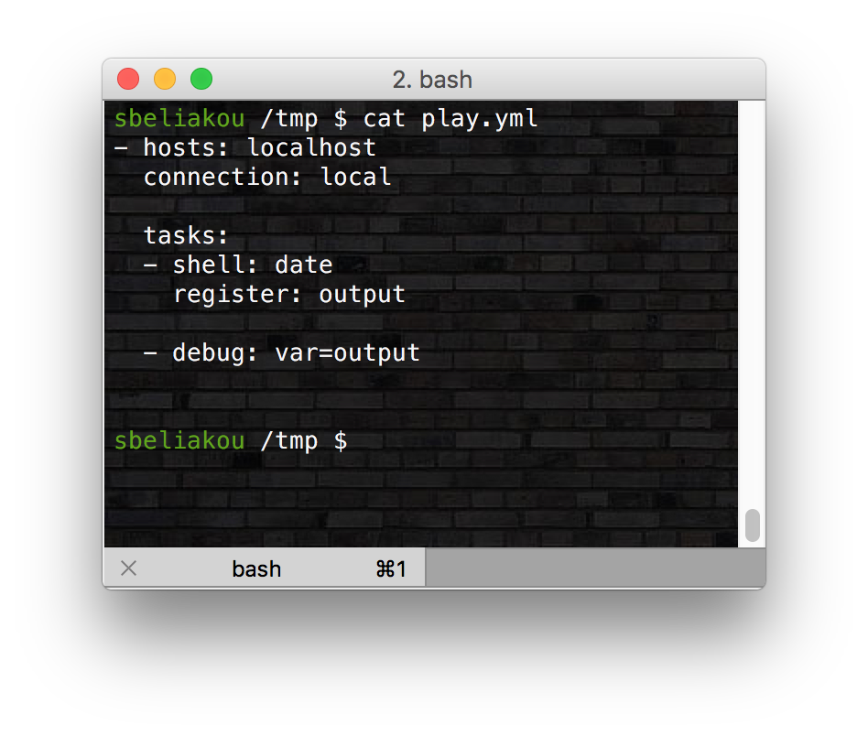
Registered Variables
http://docs.ansible.com/ansible/playbooks_variables.html#registered-variables

Slide 23
Discovered data

Slide 24
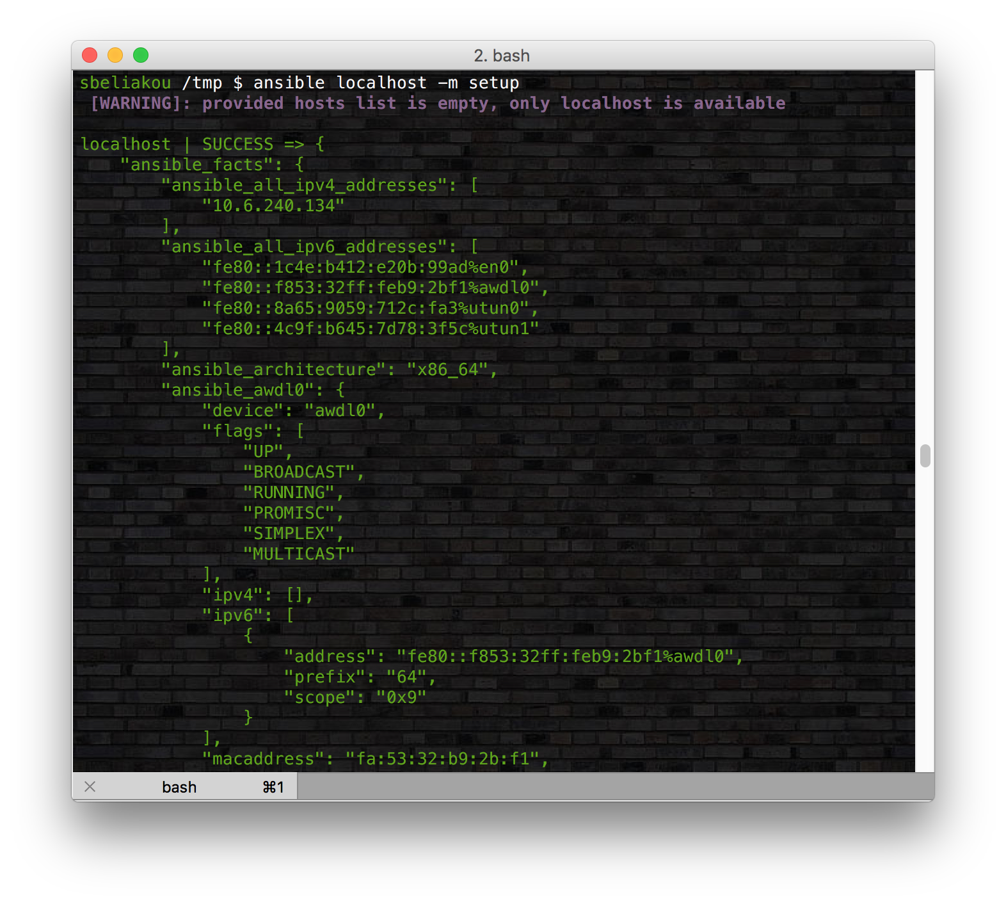
Discovered data. System facts
{{ ansible_nodename }}
{{ ansible_hostname }}
{{ ansible_fqdn }}
{{ ansible_kernel }}
{{ ansible_memory_mb.real.total }}
{{ ansible_os_family }}
{{ ansible_pkg_mgr }}
{{ ansible_service_mgr }}
{{ ansible_mounts }}

Slide 25
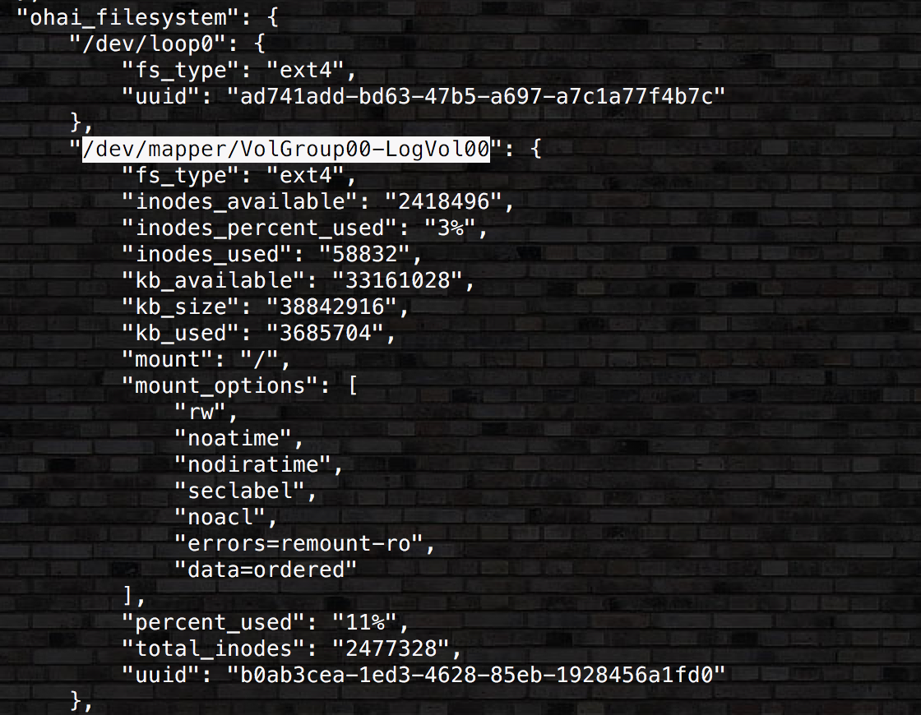
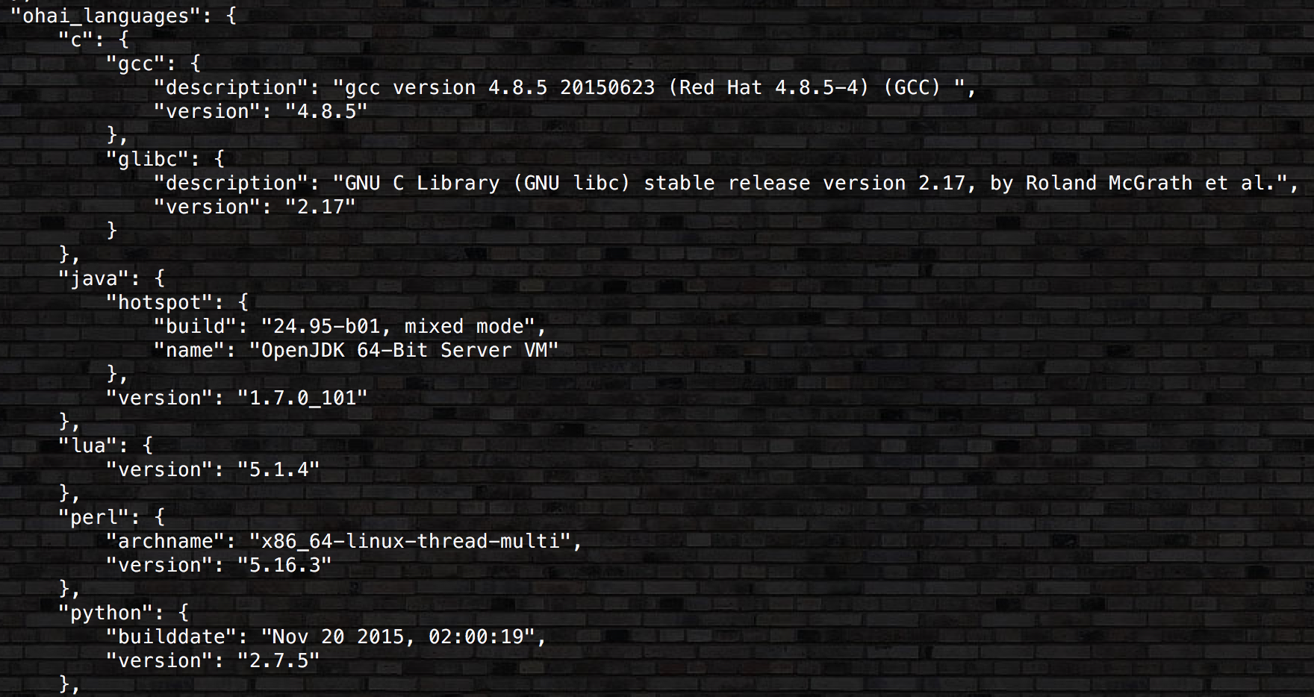
Discovered data. System facts

Slide 26
Discovered data. System facts
Turning Off Facts
If you know you don’t need any fact data about your hosts, and know everything about your systems centrally, you can turn off fact gathering. This has advantages in scaling Ansible in push mode with very large numbers of systems, mainly, or if you are using Ansible on experimental platforms. In any play, just do this:
- hosts: whatever
gather_facts: no

Slide 27
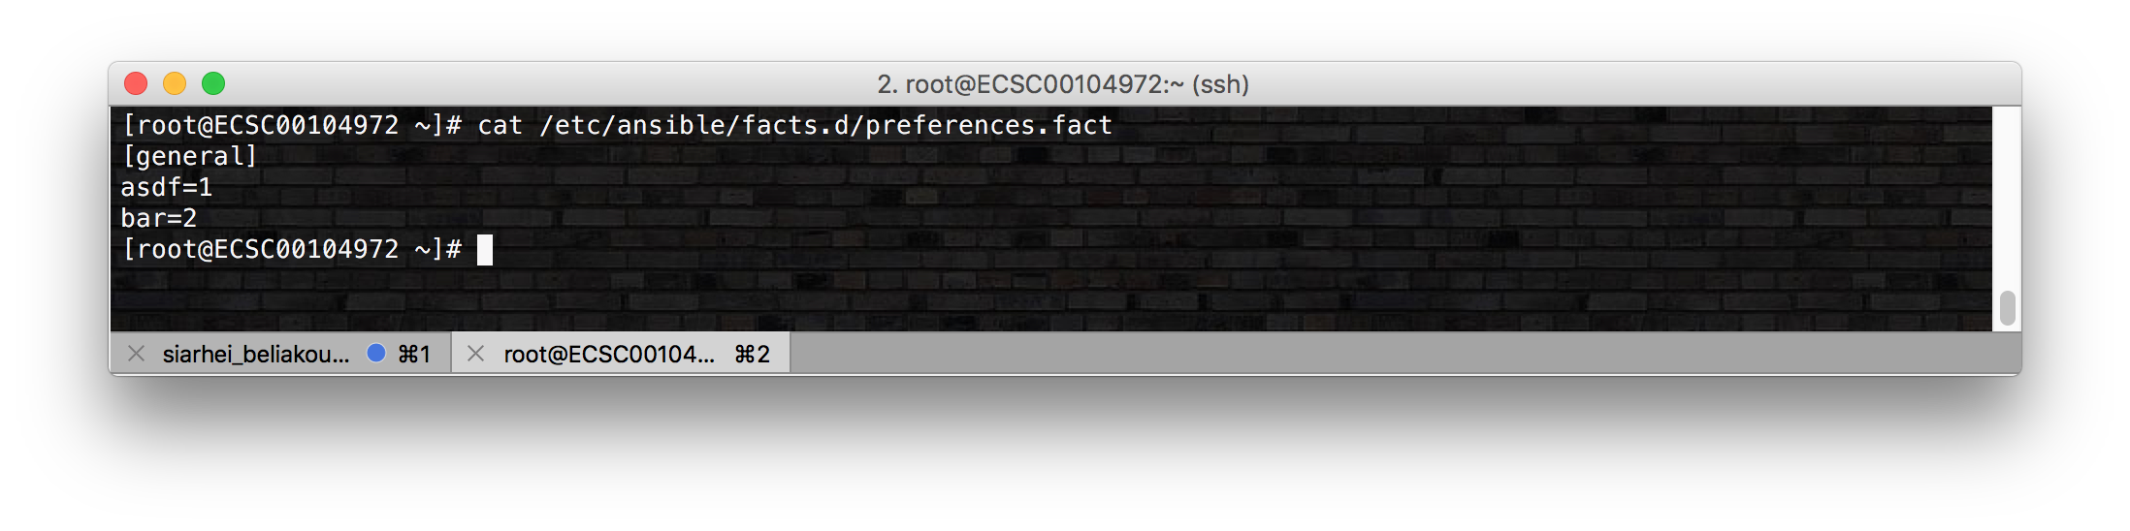
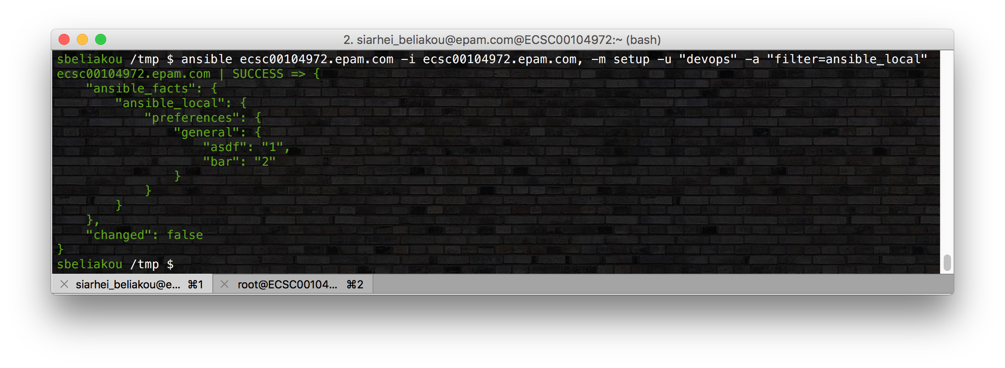
Discovered data. Local facts
http://docs.ansible.com/ansible/playbooks_variables.html#local-facts-facts-d

Slide 28
handlers

Slide 29
handlers
Handlers: Running Operations On Change
Modules are written to be ‘idempotent’ and can relay when they have made a change on the remote system. Playbooks recognize this and have a basic event system that can be used to respond to change.
These ‘notify’ actions are triggered at the end of each block of tasks in a playbook, and will only be triggered once even if notified by multiple different tasks.

Slide 30
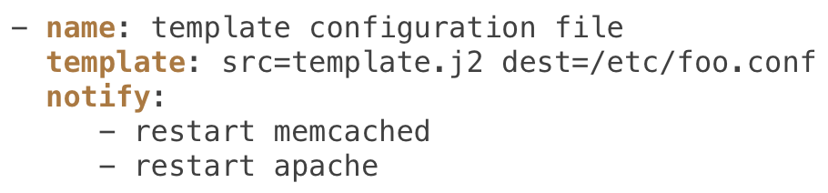
handlers
For instance, multiple resources may indicate that apache needs to be restarted because they have changed a config file, but apache will only be bounced once to avoid unnecessary restarts.
Here’s an example of restarting two services when the contents of a file change, but only if the file changes:

Slide 31
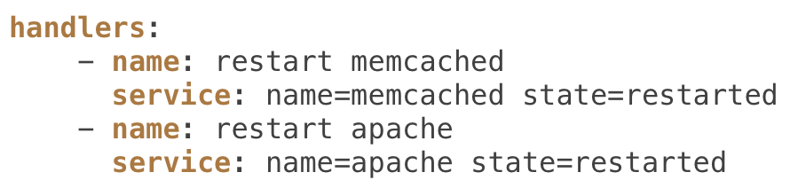
handlers
Handlers are lists of tasks, not really any different from regular tasks, that are referenced by a globally unique name. Handlers are what notifiers notify. If nothing notifies a handler, it will not run. Regardless of how many things notify a handler, it will run only once, after all of the tasks complete in a particular play.

Slide 32
Flush handlers
- template:
src: new.j2
dest: /etc/config.txt
notify: myhandler
- name: force all notified handlers to run at this point, not waiting for normal sync points
meta: flush_handlers
https://docs.ansible.com/ansible/meta_module.html

Slide 33

Enough for today ☺
QUESTIONS?
MTN.*NIX
Automated Environment Configuration Management

